Slide 1
Heart Disease UCI
Prediction of heart disease using machine learning algorithms
BY
Y.VENKATA SAI
Reg no:37120085
GUIDE:JITHINA JOSE

Slide 2
INTRODUCTION
This database contains 76 attributes, but all published experiments refer to using a subset of 14 of them. In particular, the Cleveland database is the only one that has been used by ML researchers to this date.
The "goal" field refers to the presence of heart disease in the patient. It is integer valued from 0 (no presence) to 1.
This project is used to find whether the patient is having heart disease or not based on properties.
Here we are using Supervised machine Learning Techniques to solve the dataset.In Supervised machine Learning we are using Classification Algorithms to solve the dataset.

Slide 3
DEFINITIONS
Machine Learning: Machine which learn the things with past experience (knowledge/data).
Supervised Machine Learning: This algorithm consist of a target/outcome variable(dependent variable)which is to be predicted from the given set of predictors(independent variable) using these set of variables we generate a function that maps inputs to desired outputs.
Classification: A classification problem is when output variable is a category,such as ‘disease’ or ‘no disease’.

Slide 4
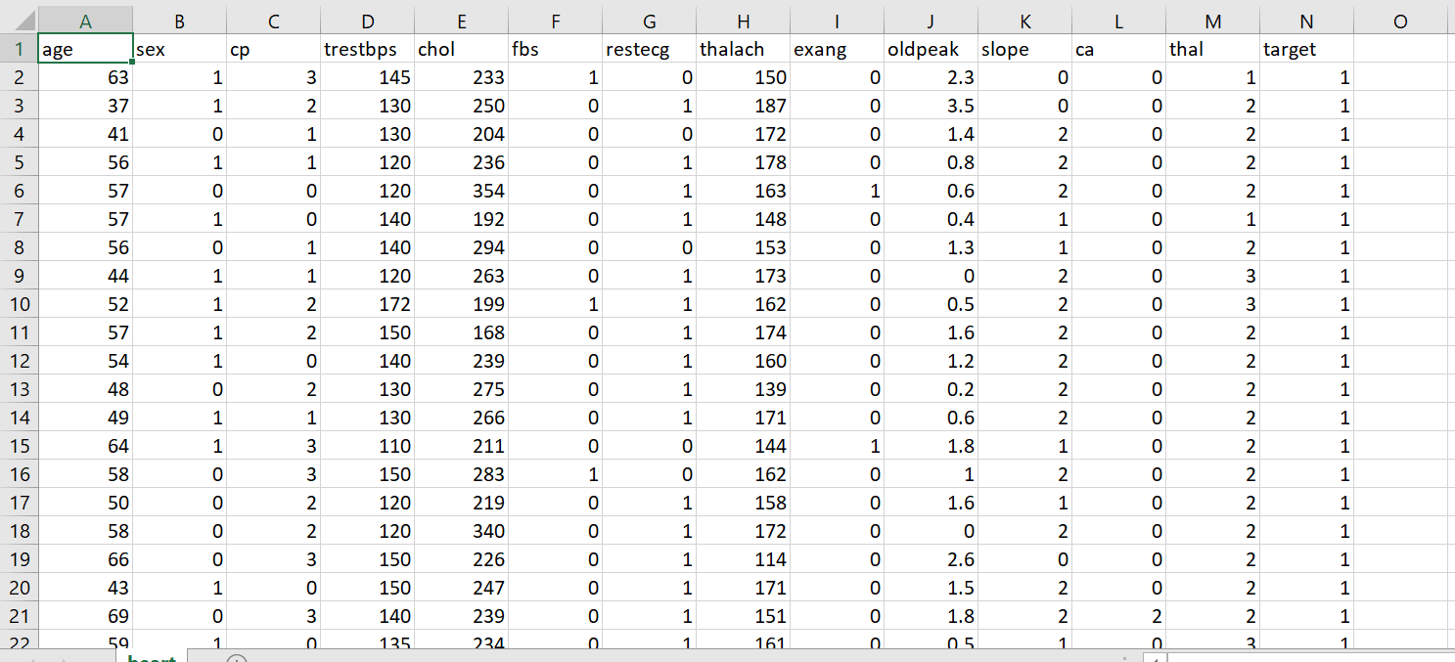
DATASET

Slide 5
ATTRIBUTE INFORMATION
Age .
Sex(male,female).
CP:Chest pain type (4 values).
Trestbps:Resting blood pressure
Chol:Serum cholestoral in mg/dl
Fbs:Fasting blood sugar > 120 mg/dl
Restecg:Resting electrocardiographic results (values 0,1,2)
Thalch:Maximum heart rate achieved
Exang:Exercise induced angina
Oldpeak = ST depression induced by exercise relative to rest
Slope:The slope of the peak exercise ST segment
Ca:Number of major vessels (0-3) colored by flourosopy
Thal: 3 = normal; 6 = fixed defect; 7 = reversable defect

Slide 6
SYSTEM ARCHITECTURE
HEART DISEASE DATASET
IMPORTINGMODULES
PREPROCESSING
DATA PARTISIONING
CONFUSION MATRIX
PREDECTING RESULT
MODEL BUILDING

Slide 7
METHODOLOGY
MODULES
Data preprocessing.
Data visualization.
Data partisioning.
Model Building.

Slide 8
DATA PREPROCESSING
Step 1: Import required modules.
Step 2: Read dataset using pandas.
Step 3: Print statistical values of dataset.
Step 4: Convert string data into numerical data using label encoder.
Step 5:Drop some unused columns present in dataset.

Slide 9
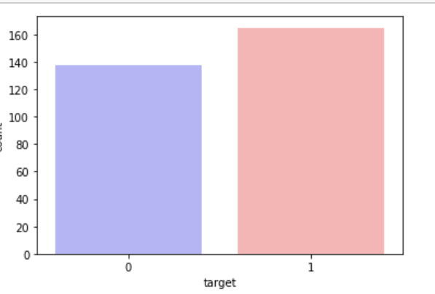
DATA VISUALIZATION
Countplot:countplot is drawn based on target attribute.
If target=0 person is having no disease.
If target=1 person is having disease.

Slide 10
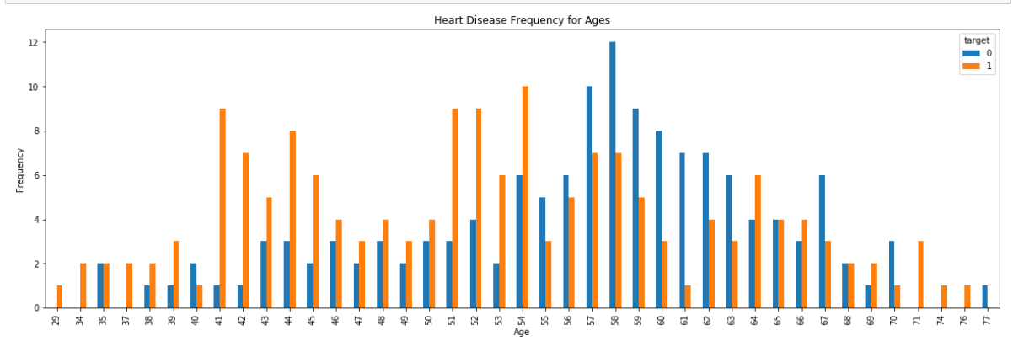
CROSS TAB
Cross tab:cross tab relates between age and target.
It shows no of people are getting heart diseases according to age.

Slide 11
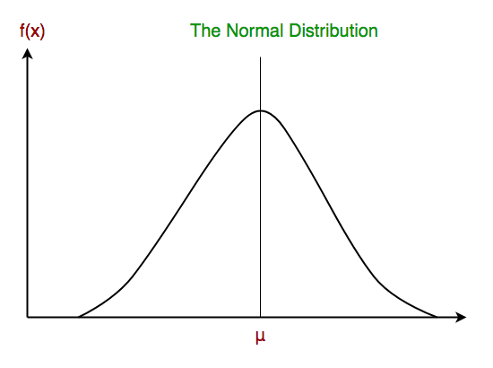
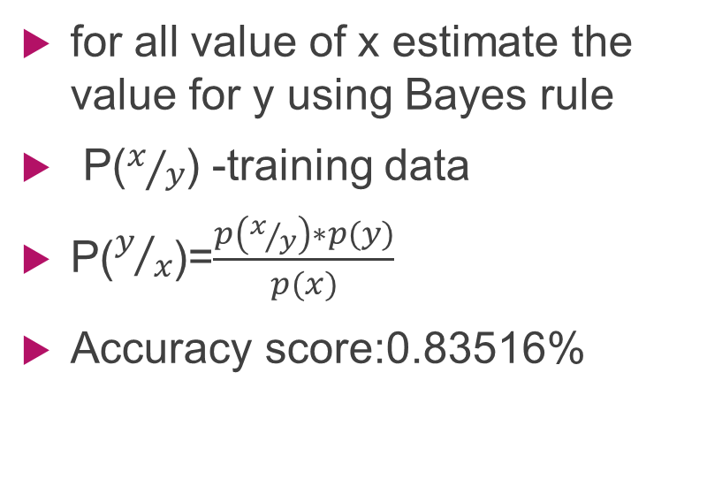
GAUSSIAN NAÏVE BAYES
for all value of x estimate the value for y using Bayes rule
P($x/y$) -training data
P($y/x$)=$\frac{p\left(x/y\right)∗p(y)}{p(x)}$
Accuracy score:0.83516%

Slide 12
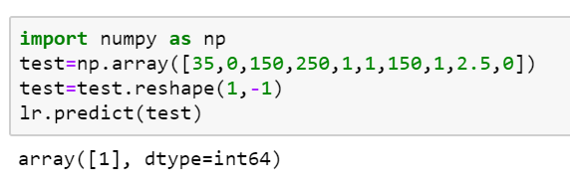
FUTURE PREDICTION

Slide 13
SYSTEM SPECIFICATION
HARDWARE REQUIREMENTS:
System : Intel I3 processor and above.
Hard Disk : 80 GB.
Ram : 4 GB and Above.
SOFTWARE REQUIREMENTS:
Operating system : Windows 7 and Above.
Coding Language : Python.
Framework : Django.
Designing : Html,css,javascript.

Slide 14
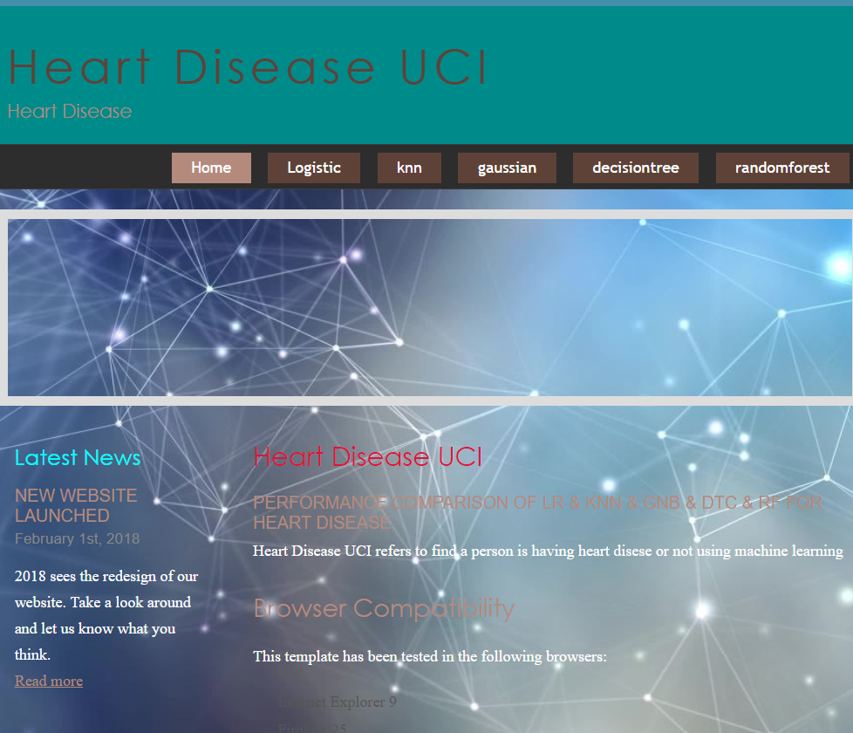
OUTPUT-SCREENSHOTS

Slide 15
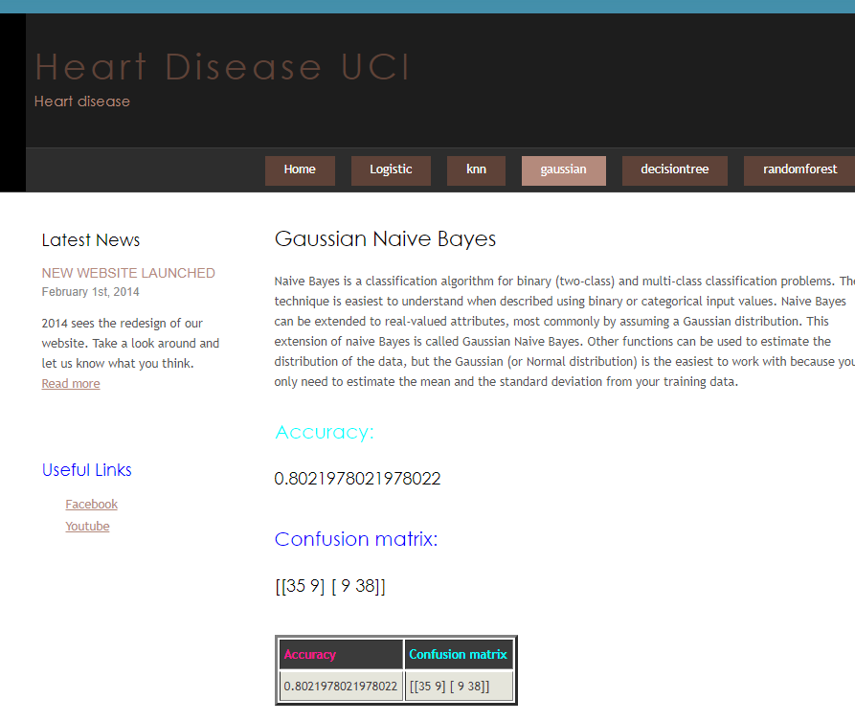
GAUSSIAN NAIVE BAYES

Slide 16
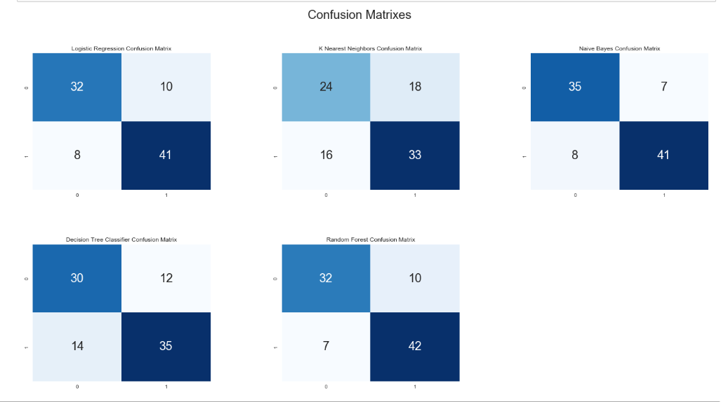
COMPARISION CONFUSION MATRICES

Slide 17
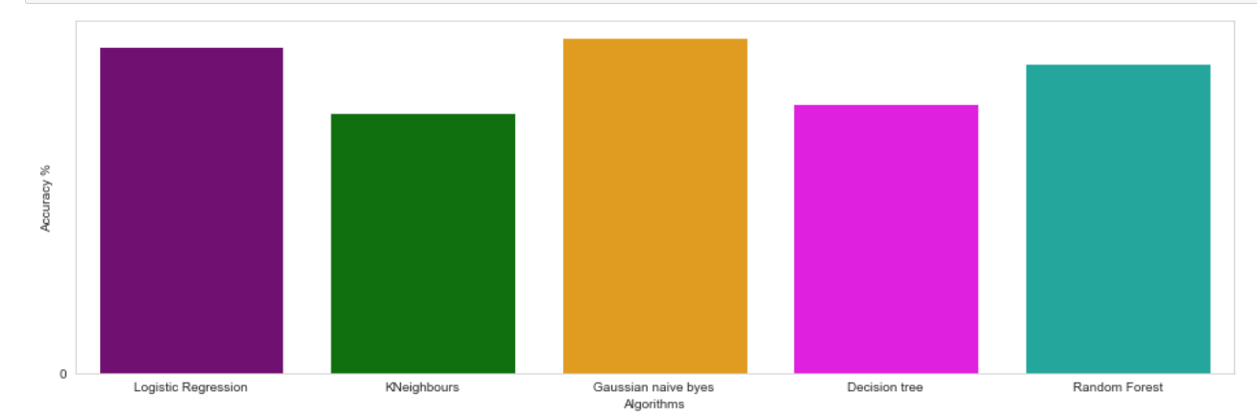
COMPARISION OF ACCURACY SCORES

Slide 18
CONCLUSION
Hence this project is useful in hospitals for finding heart diseases for people who is suffering with symptoms .
The proposed system heart disease uci-based on Changes in heart disease for individual person to determine heart disease for human body to prevent from major health risks.
This method of classification through machine learning algorithm is a reliable and efficient methodology .

Slide 19
THANK YOU

